Slide 1
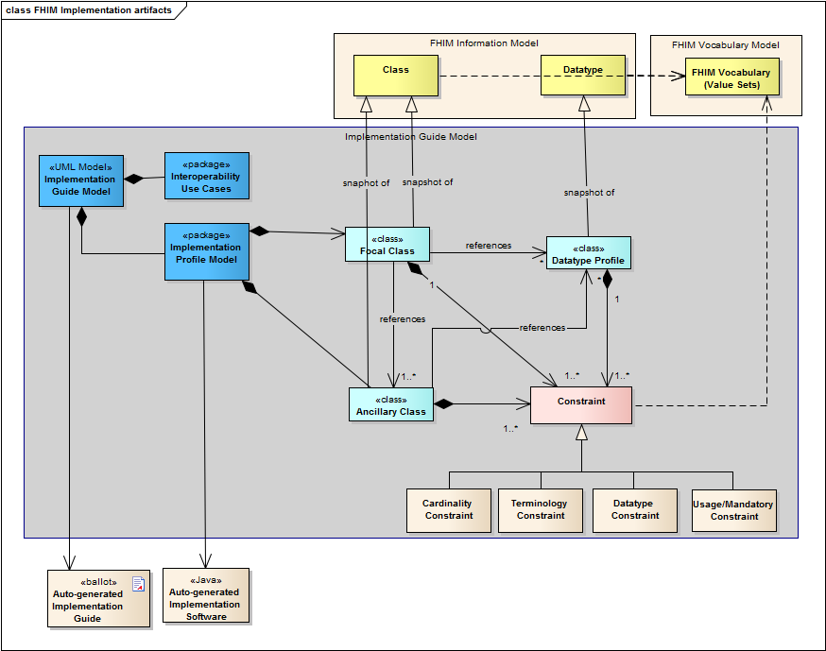
Implementation Guide Modeling Artifacts

Slide 2
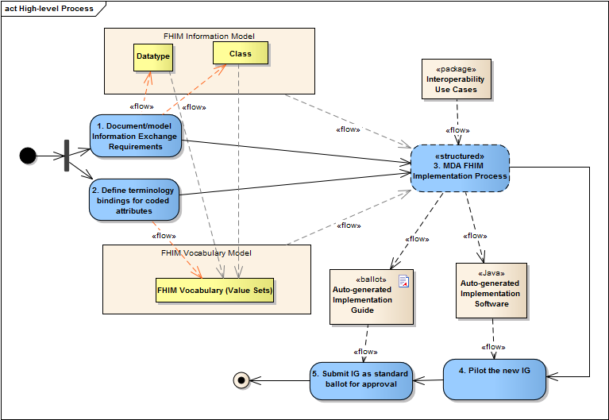
Implementation Process
Notes:
Document the information required for exchange in the FHIM Information Model. FHIM is a platform independent model (PIM) model describing the information exchange requirements of FHIM stakeholders. The result of this activity is to create a FHIM UML model organized into packages/domains. Each domain contains the information required to exchange information among systems in a specific business area.
Define terminologies and value sets for coded data attributes in the FHIM Terminology model. This FHIM Terminology is a UML model that contains all references to all coding system and value set versions used by coded attributes of FHIM classes. This model will also contain coding system version and subsets used by implementation guides based on FHIM.
Follow a Model Driven Architecture (MDA) process guide to produce a draft implementation guide as described in section 7. The following is a high-level summary of the approach:
Identify the specific use case(s) for exchange of information
Identify the target Platform Specific Model(s) (PSM) to support the exchange
Constrain the FHIM and associated terminologies/value sets to generate a PIM that contains the information needed to support the use case
Use the use case PIM to generate the target PSM
Use the PSM to generate artifacts for the target implementation standard
Pilot test the draft implementation containing constraints and extensions to the base standards in PSM and based directly on the contents of the PIM
Submit the draft implementation guide to an SDO/SRO for ballot/approval; if the project requirements require specific extensions in the base standards (i.e. PSM) additional change requests will be submitted for each extension or gap that needs to be addressed.

Slide 3

FHIM Model Driven Prototype
Approach
1
FHIM Model
(PIM)
NIEM Health Domain
Harmonized
Uses
Lab Domain Integration Use Case
Constrains
2
Platform Independent
Uses
Lab Domain Exchange (PIM)
4
5
Platform Specific
MDHT
Transform
CDA Exchange PSM (UML)
NIEM Exchange PSM (UML)
8
Generate
Transform
Transform
Generate
9
6
7
CDA Implementation Guide Document
CDA Exchange Implementation
(Java)
NIEM Exchange PSM Implementation
(XSDs)
NIEM IEPD
Document

Slide 4
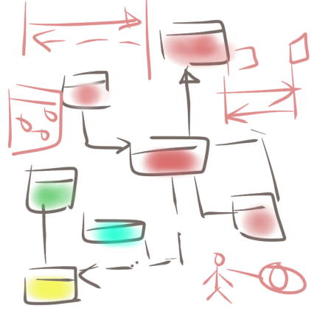
Prototype Step - 1
FHIM.emx
HITSP IS01
FHIM.emx
1
3
Use Case
Information
Requirements
Semantic Model Metadata
2
Harmonized
HITSP C35. C36, C37, C83
Value Set Binding
Coded Concept
HITSP C80/35
Terminology Model
Standard Coding System
Standard Coding System
Standard Coding System
Standard Coding System
Twitter #NIEMNTE1

Slide 5
Prototype Step - 2
CDA HITSP C37
FHIM.emx
Constraints
4
Header
Clinical Document
*
*
*
Section
*
Entry
Choice
Act
5
Constraints
Encounter
Extensions
NIEM
Observation
References
Media
Extension
Organizer
Procedure
Use Case
Region of Interest
Terminology Model
IEPD
Substance Administration
RSA 8.02 + MDHT Tools
constraints
<template> LabResult
Supply
Twitter #NIEMNTE1

Slide 6
MDA: PIM-to-PSM and Testing Approach
Information
Requirements
Use Case
Terminology Model
PIM
PSM
CDA JAVA API
NIEM XSD
NCPDP SCRIPT XSD
HL7 V3 XSD
HL7 V2 XML Profiles
Other Examples
Test Cases
Reference Implementation
Reference Implementation
Reference Implementation
Reference Implementation
Test Cases
Test Case
Validation/Test Harness
Twitter #NIEMNTE1

